Slide 1



SP190 TP1 - Seamless Hybrid Control Real-time capabilities of container environments September 30, 2018

Slide 2
Executive Summary
The results are based on a master thesis with the TU München, running from March 2018 til September 2018
The context of the master thesis was to evaluate real-time capabilities of container environments (run-time and orchestration) in the context of seamless computing
Background
Containers (Docker) produce little to no overhead as compared to bare metal machines (Linux). In the investigated scenarios (running multiple real-time processes with little CPU load on a host that has 100% non real-time background load), latency boundary stays in the same order of magnitude (~40-80 μs).
Real-time containers can be started using Kubernetes. Some basic scenarios for scheduling of real-time containers in a mixed cluster (real-time as well as non real-time nodes and containers) could be support with existing Kubernetes scheduler features.
Results

Slide 3
Scope and structure of the Master Thesis
Literature review
Measurements
Select a suitable Real-time operating system
Identify meaningful real-time metrics
Find out the measurement methods of chosen metrics
Conduct measurements for real-time system in different scenarios to get a baseline
Conduct same measurements for a system running Docker containers
Conduct same measurements for different scenarios
Analysis of results
Orchestration
Explain the alterations of system behavior after using containers.
Analyze how Docker containers are implemented to explain the measurement results
Evaluate options to manage real-time enabled containers based on Kubernetes container orchestration
Investigate which real-time scenarios can be implemented with Kubernetes
Find out the current limitations of the orchestration level on supporting the real-time requirements

Slide 4
Results of Literature Review
Which real-time operating system suites our needs best
Preempt_RT patch
Which benchmarks exist to measure those metrics in different scenarios
Cyclictest
hackbench
Figure out what are the performance metrics for real-time systems
Scheduling latency

Slide 5
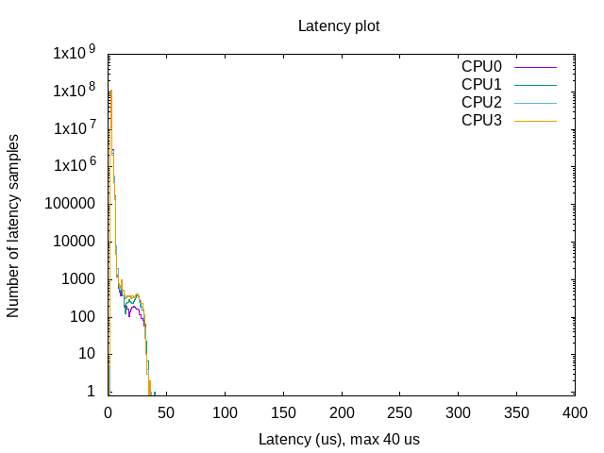
Measurements Hardware: HP EliteBook 8570p intel core i7 Software: Linux kernel version 4.18.7 Real-time patch: Preempt_RT version 4.18.7-rt5
Cyclictest in the system with full load (using hackbench)
Cyclictest
# Min Latencies: 00002 00002 00002 00001
# Avg Latencies: 00003 00003 00003 00003
# Max Latencies: 00035 00040 00037 00036
# Histogram Overflows: 00000 00000 00000 00000
# Histogram Overflow at cycle number:
# Thread 0:
# Thread 1:
# Thread 2:
# Thread 3:
This experiment is conducted on pure Linux machine without containerization. These measurement results are taken as a baseline for evaluation of future latency results

Slide 6
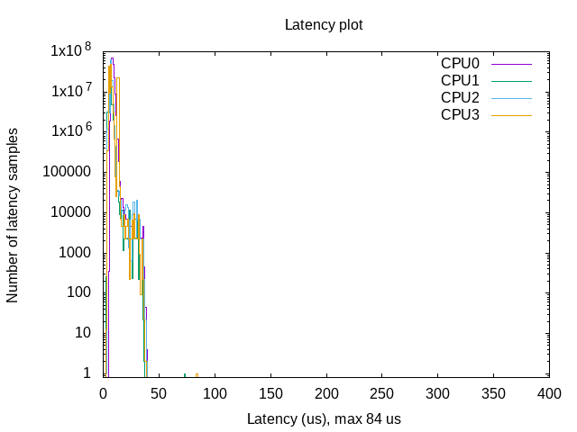
Measurements with a Docker container
Cyclictest and hackbench running in a Docker contianer
Cyclictest
# Min Latencies: 00005 00003 00003 00003
# Avg Latencies: 00008 00005 00006 00006
# Max Latencies: 00036 00073 00036 00084
# Histogram Overflows: 00000 00000 00000 00000
# Histogram Overflow at cycle number:
# Thread 0:
# Thread 1:
# Thread 2:
# Thread 3:

Slide 7
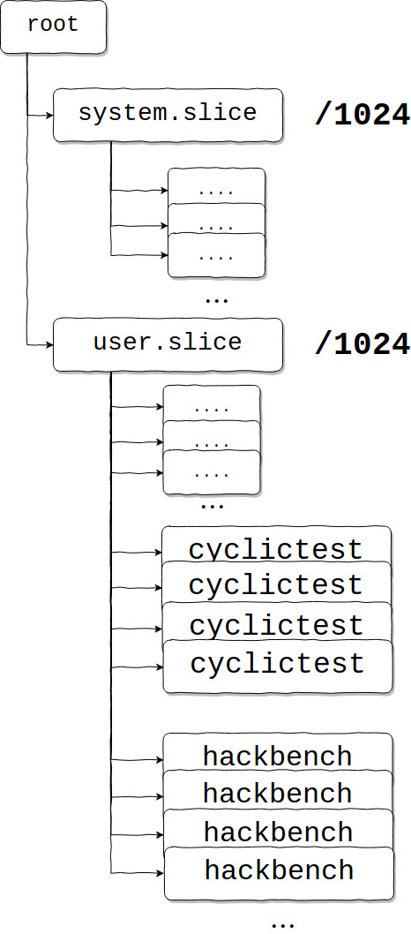
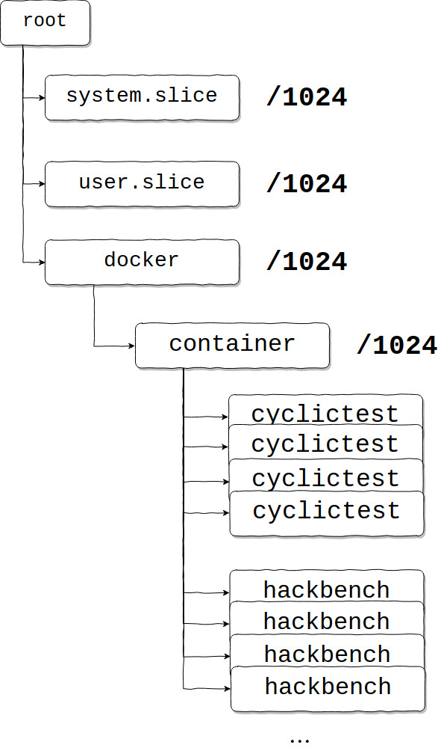
Cgroups on the kernel while running one instance of cyclictest
A.
B.
A. Cgroups on the kernel while running one instance of cyclictest and hackbench on pure machine without containers.
B. Cgroups on the kernel while running one instance of container packed with cyclictest and hackbench

Slide 8
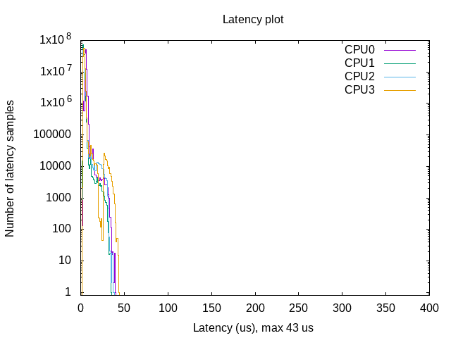
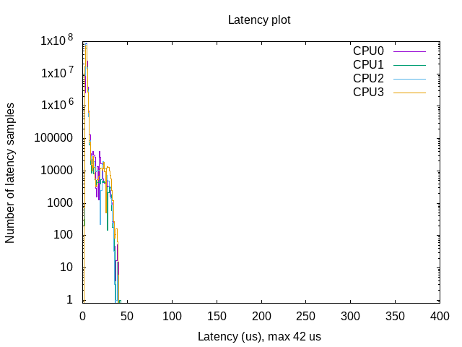
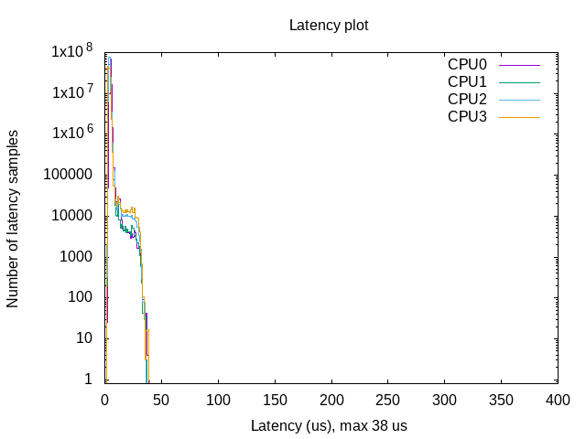
Running three simultaneous containers with different cpu shares
Running three containers with different cpu-shares and priorities: 70, 80, 90
Prio = 80
This was done by starting one of the containers with the flag
--cpus=0.5
Prio = 70
Prio = 90

Slide 9
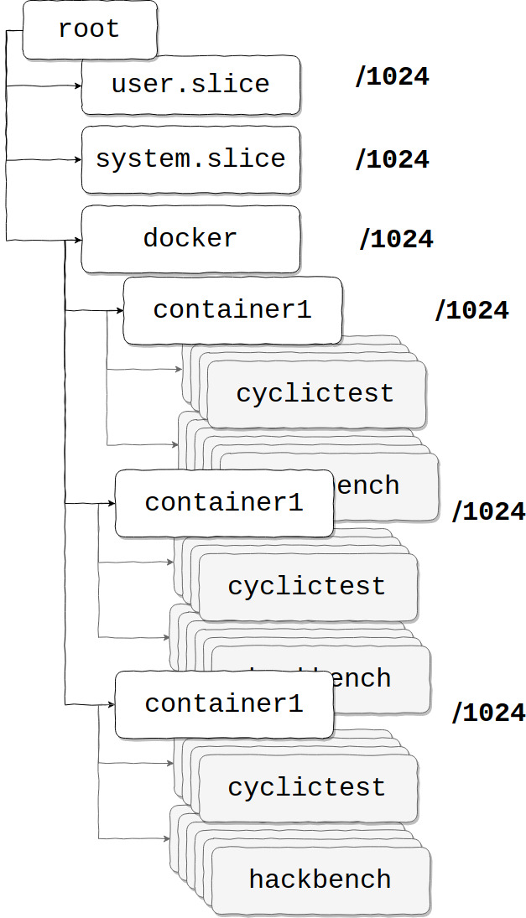
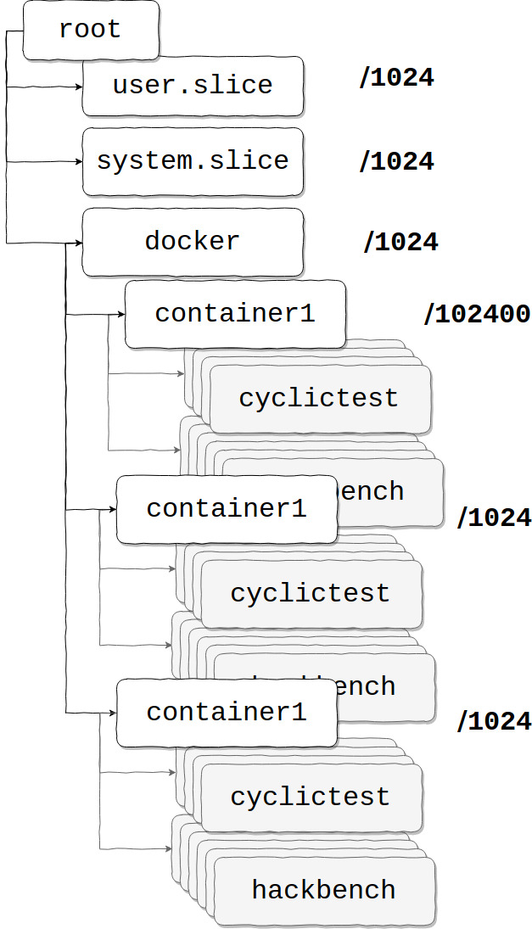


Cgroups on the kernel while running three containers simultaneously
A.
B.
A. Cgroups on the kernel while running three containers packed with cyclictest and hackbench.
B. Cgroups on the kernel while running three containers with different cpu shares.

Slide 10
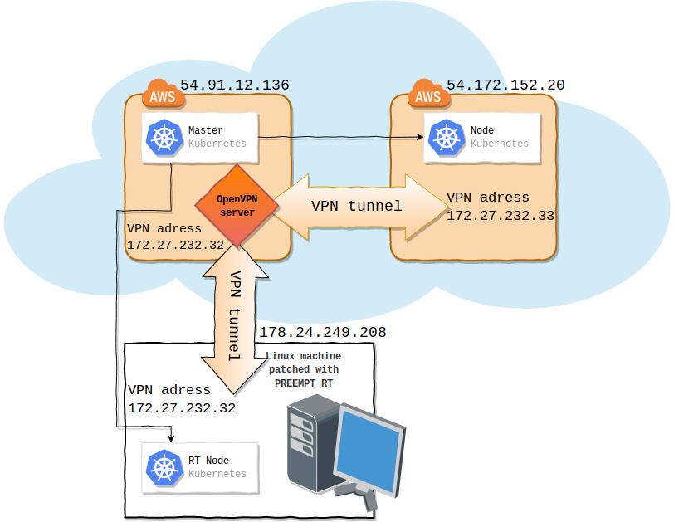
Orchestration of Real-time containers
Architecture of Orchestration layer
Kuberentes cluster consists of three nodes:
Master node on AWS
Minion node on AWS
RT compatible node PC
Communication between nodes is done through VPN tunneling

Slide 11

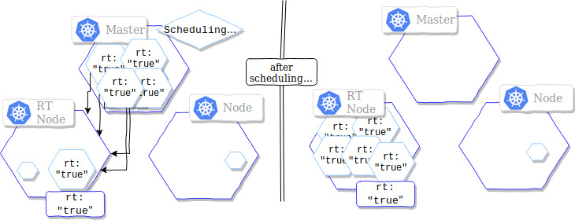
RT pods are scheduled to RT nodes only
Node joins to the cluster with appropriate flags
Pods need to have an appropriate nodeSelector key-value pair to be scheduled only to an RT node
KUBELET EXTRA ARGS==--node-labels=rt=true

Slide 12
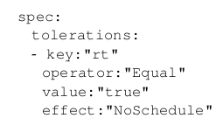
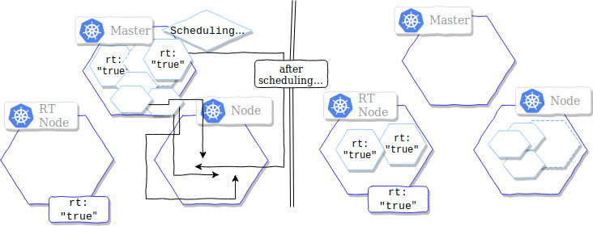
Scenario 1: no non-real-time pods on an RT node
Taints are added to the node while joining the cluster
Pods that want to be able to run on RT nodes have to tolerate those taints
KUBELET EXTRA ARGS==--node-labels=rt=true
--register-with-taints="rt=true:NoSchedule"

Slide 13
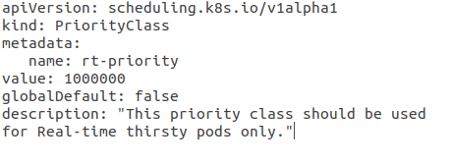
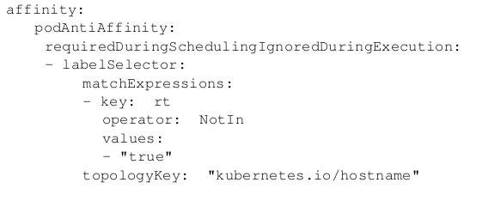
Scenario 2: non-real-time pods are allowed until a real-time pod arrives
We create a priority configuration class for RT pods. We set the priority to 1000000.
In the spec field we specify the podAntiAffinity behavior.

Slide 14
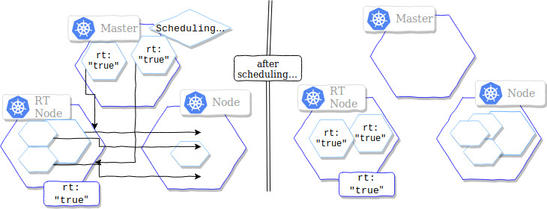
Scenario 2: non-real-time pods are allowed until a real-time pod arrives
We create a priority configuration class for RT pods. We set the priority to 1000000.
In the spec field we specify the podAntiAffinity behavior.

Slide 15
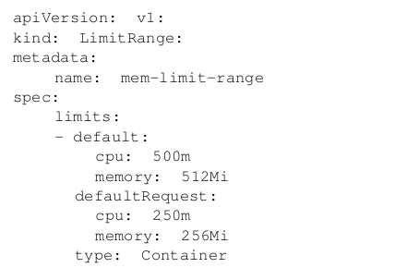

Scenario 3: non-real-time pods are allowed if there are enough resources on the node
To make this happen, we create a configuration of type LimitRange
Priority configuration from previous scenario is used again

Slide 16
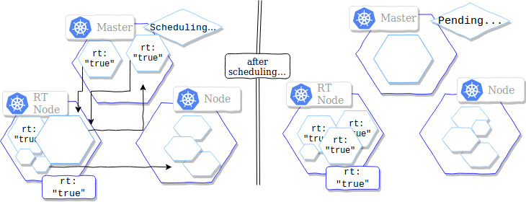
Scenario 3: non-real-time pods are allowed if there are enough resources on the node
In the spec field we specify the podAntiAffinity behavior.
To make this happen, we create a configuration of type LimitRange
Priority configuration from previous scenario is used again
We create a priority configuration class for RT pods. We set the priority to 1000000.

